Slide 1
Object Oriented Programming
Iván Guerrero Román

Slide 2
Session #27
V. GUI
Layouts
Handling events

Slide 3
Lists of elements
To create list, you need the following elements:
Data Model: Place to manage the data that will be displayed
List: User interface to display the date
Classes
ObservableList<TYPE> data;
data = FXCollections.observableArrayList();
ListView<TYPE> lvData = new ListView<>(data);

Slide 4
Main methods of the model
add (element)
remove (element)

Slide 5
Exercise
Movie manager

Slide 6
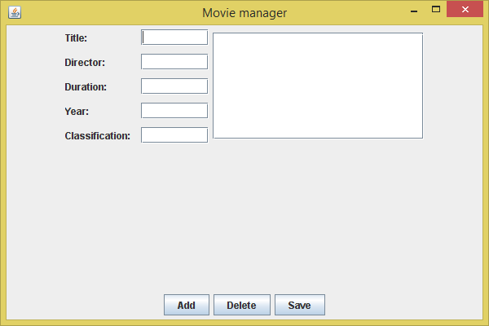
CENTER
(FlowLayout)
GridLayout
Border Layout
PAGE_END
(FlowLayout)

Slide 7
Session #27
V. GUI
Layouts
Handling events

